Slide 1
The Effects of Total Momentum Ratio of Pintle Injector Performance
By: Zoe Brand
Mentor: Dr. Elliott Bryner
College Of Engineering, Mechanical Engineering Propulsion
Arizona Space Grant Symposium
April 22nd, 2023

Slide 2
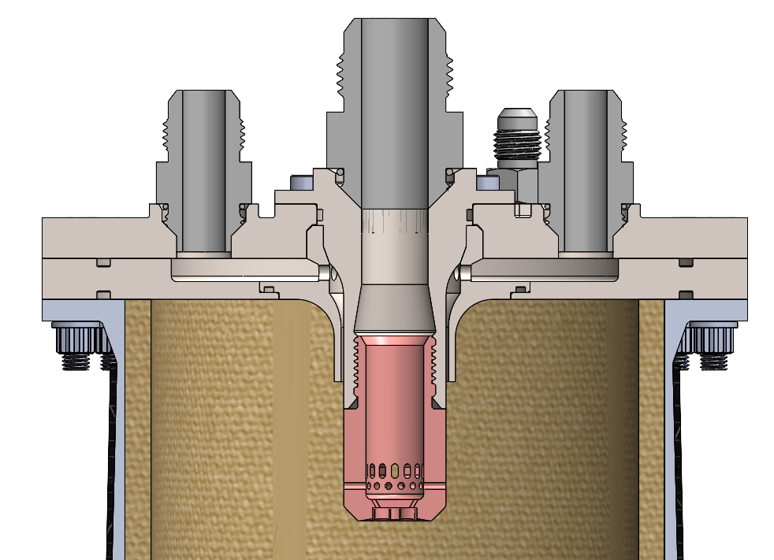

Total Momentum Ratio
Parameter used to induce complete mixing of propellants
FUEL
LOX
FUEL
Mass Flow Rates
Velocities
$$TMR=\frac{mdot_{radial} V_{radial}}{mdot_{axial} V_{axial}}$$
Axial
Radial

Slide 3
Total Momentum Ratio
Parameter used to induce complete mixing of propellants
$$TMR=\frac{mdot_{radial} V_{radial}}{mdot_{axial} V_{axial}}$$
Industry Standard
TMR =1
45º

Slide 4
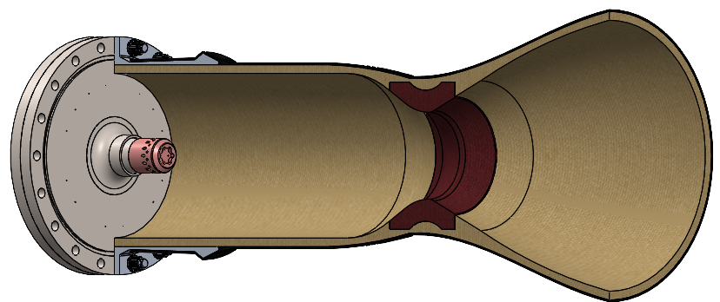
Test Article: Design Parameters
Embry-Riddles Janus 4 Engine
Injector Type: Pintle
Propellant: Jet-A, Liquid Oxygen

Slide 5
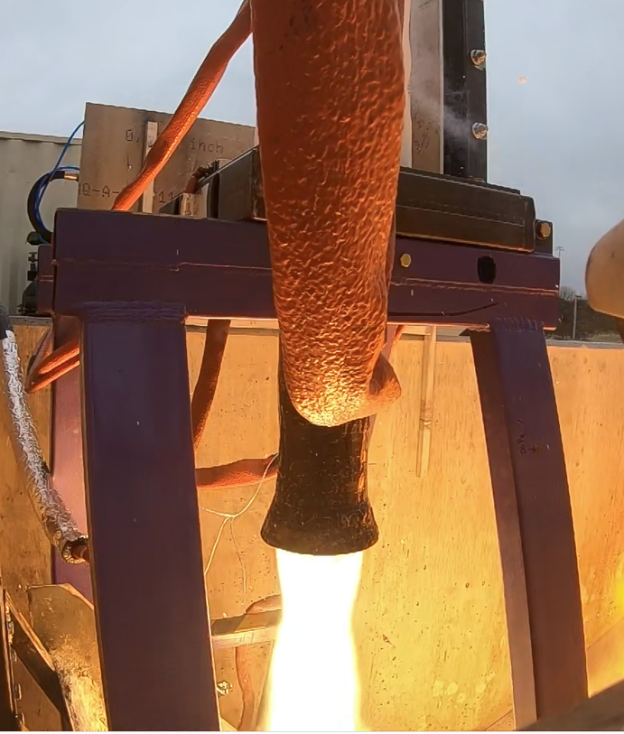
TMR Testing
TMR was validated off:
Mass Flow Rate
Engine Performance
Scorching of engine

Slide 6
Test 1 & 2: Mass Flow Rates
Industry Rule of Thumb:
  TMR=1
The ideal case dependent on Propellant Type:
  O/F for LOX/Kerosine: 2-2-2.4 (SPAD 708)
Test | O/F | Thrust Produced (lbf) | TMR
1 | 1.64 | 936 | .93
2 | 1.81 | 1350 | 1.09
Ideal case | 2.4 | 1750 | 1.166

Slide 7
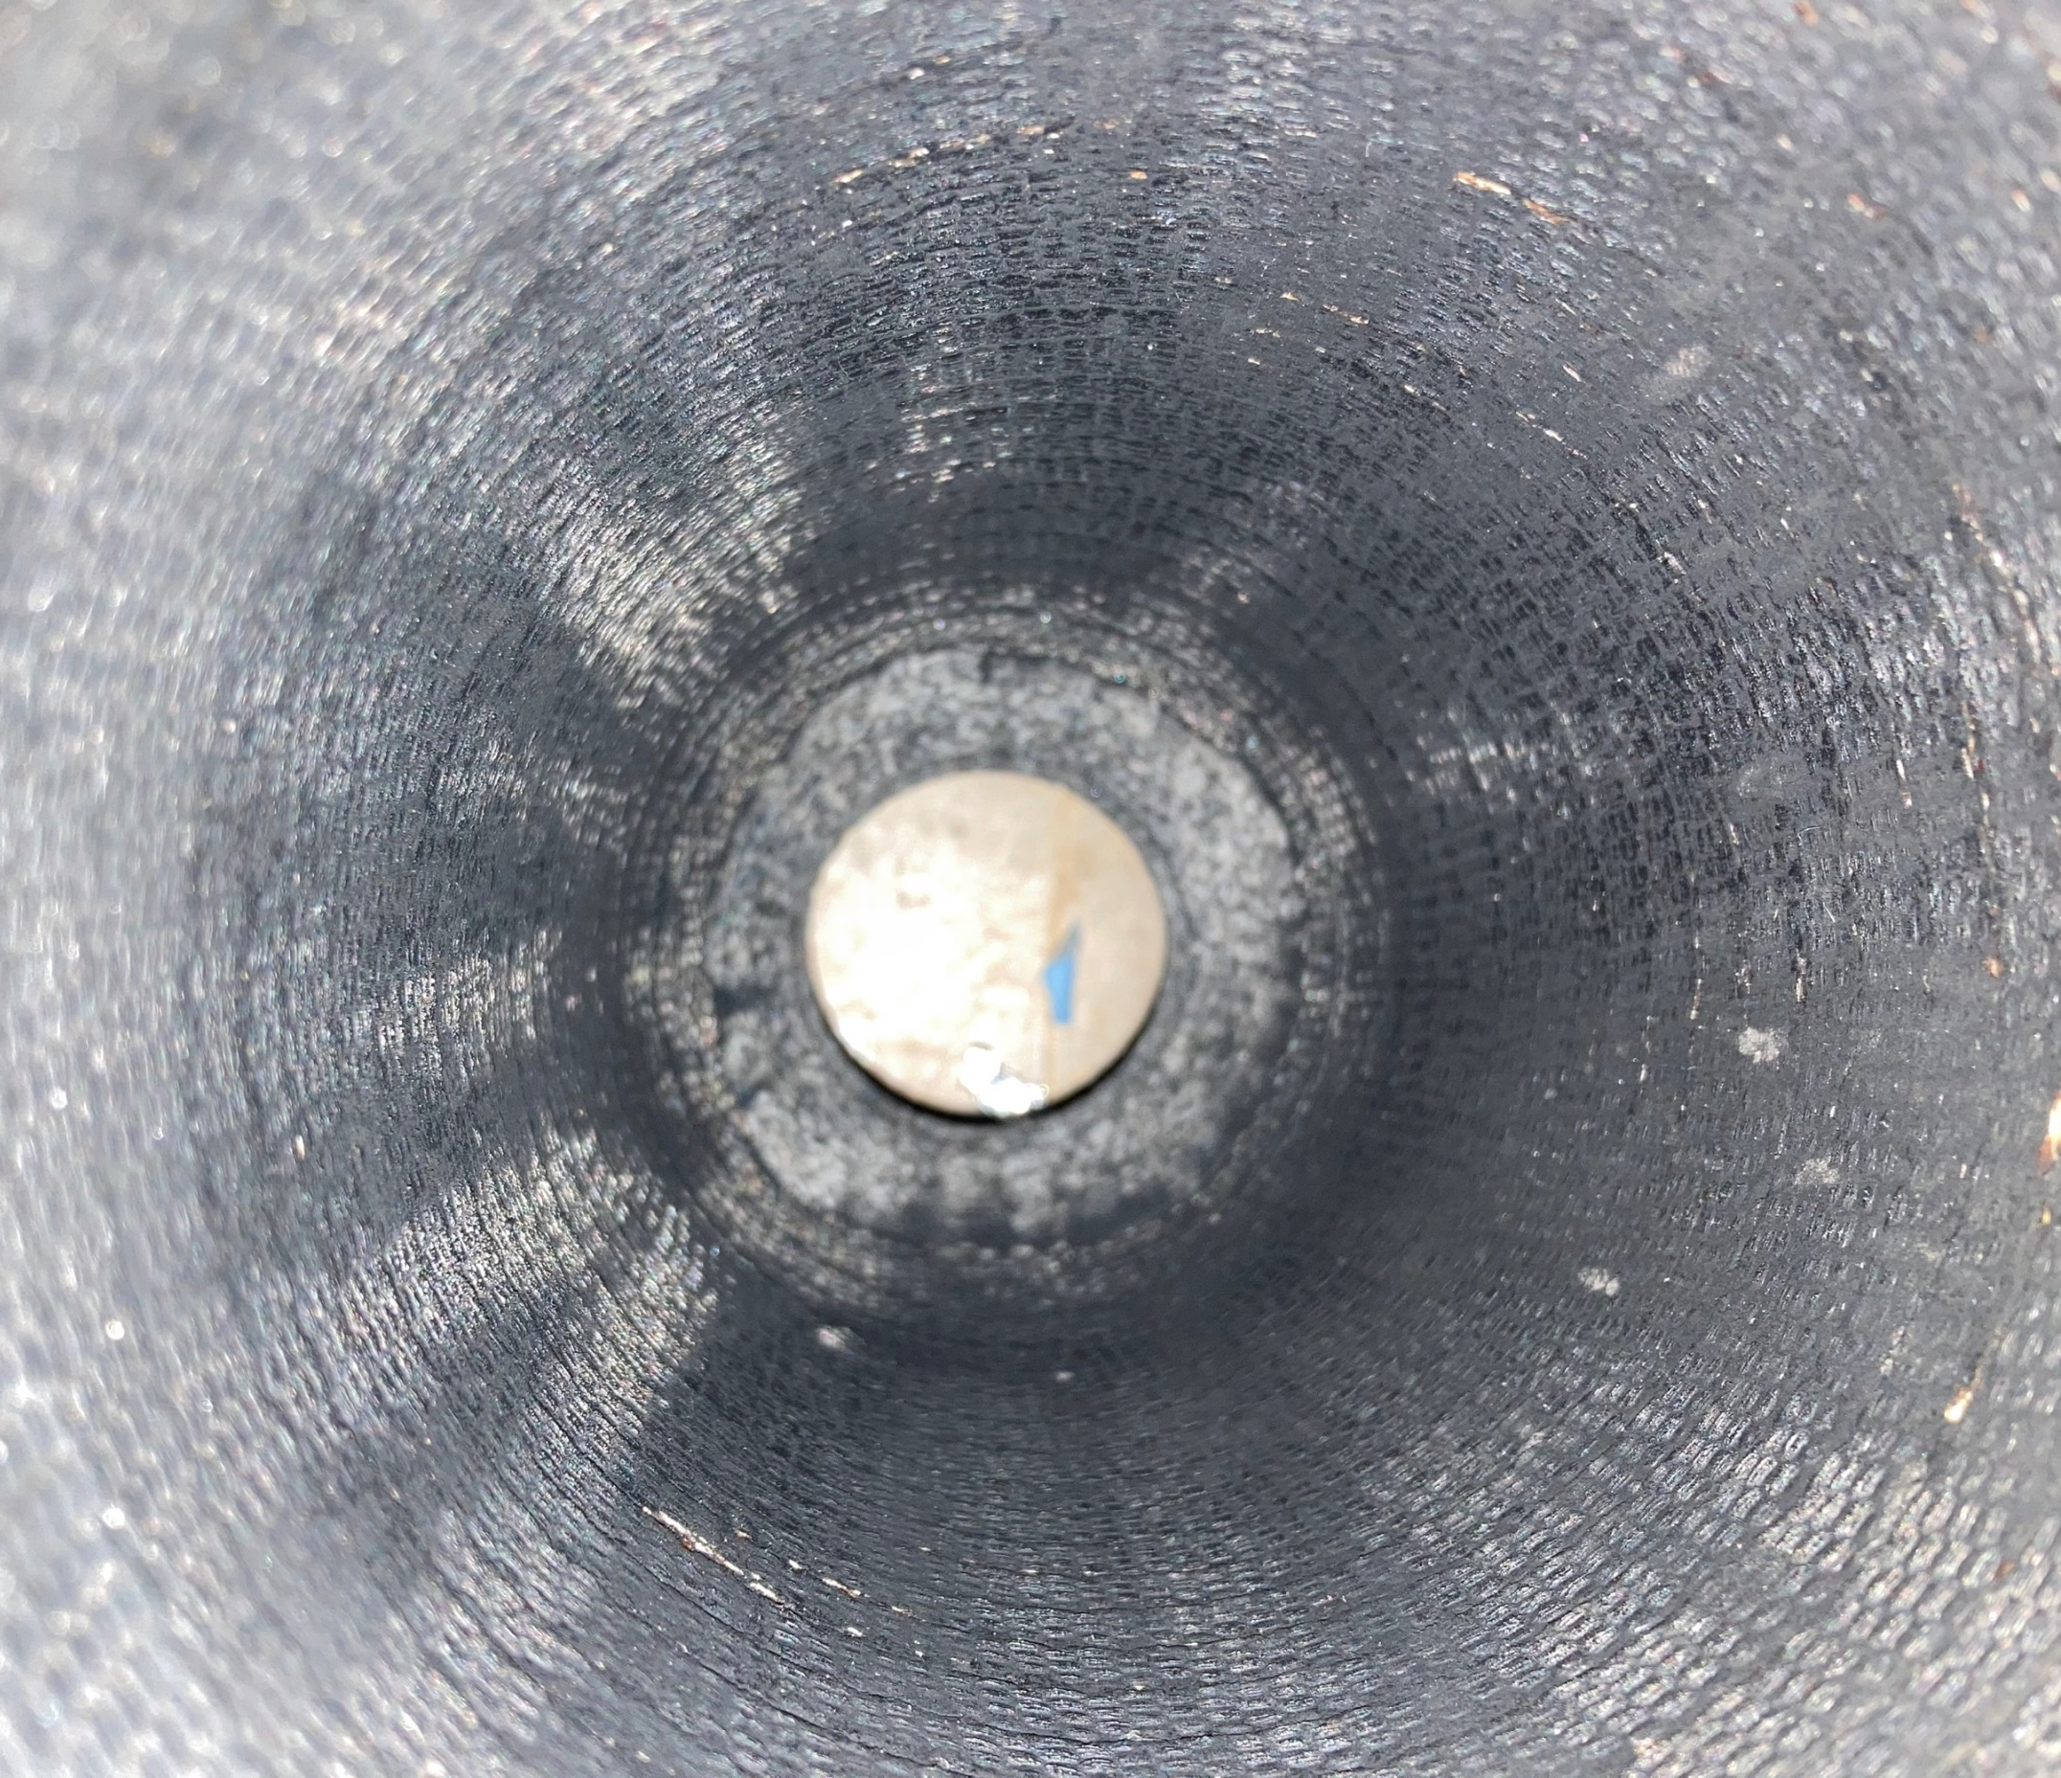
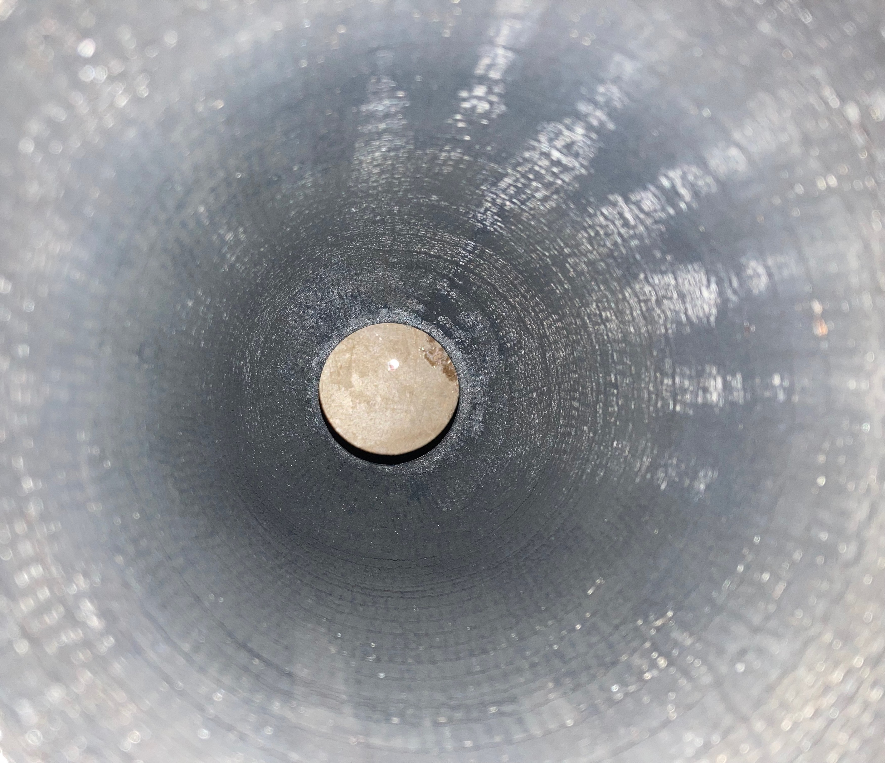
Test 1 & 2: Scorching
Hot Spots

Slide 8
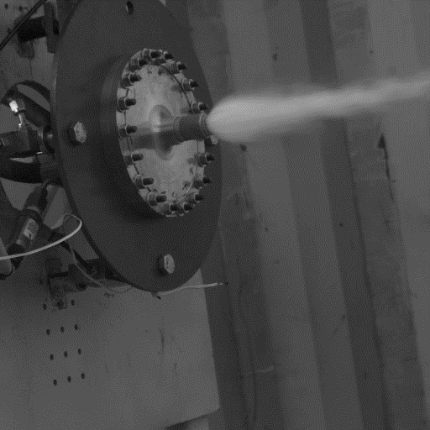
Future Testing

Slide 9
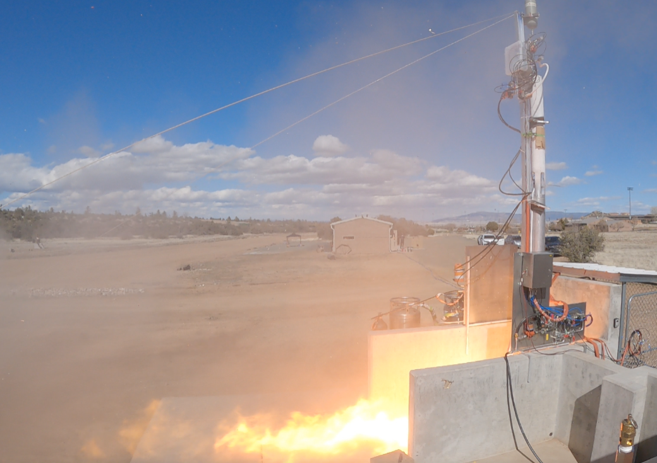
Questions?

